Slide 1
Source Code Management: Branching and Merging
Jay Smith

Slide 2
The Problem
Version 1.0 of application X was released 4 weeks ago and development work on version 2.0 is in full swing and a bug has been discovered.
The current state of the project won’t allow you to just fix the bug and release.
What do you do?

Slide 3
Branching
Branching is the duplication of an object under revision control (such as a source code file, or a directory tree) so that modifications can happen in parallel along both branches.

Slide 4
Merging
Merging is the act of reconciling multiple changes made to different copies of the same file. Most often, it is necessary when a file is modified by two people on two different computers at the same time. Later, these changes are merged, resulting in a single new file that contains both sets of changes.

Slide 5
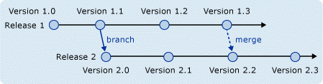
Branch per Release

Slide 6
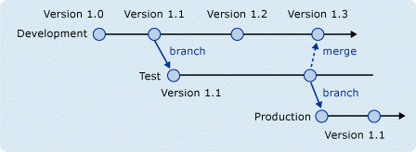
Copy Promotion Branch

Slide 7
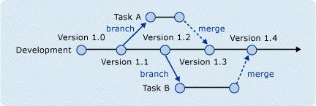
Branch per Task

Slide 8
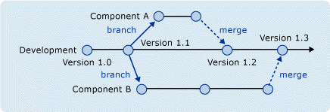
Branch per Component

Slide 9
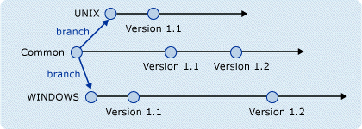
Branch per Technology

Slide 10
Resources
VS 2005 Technical Article: Branching and Merging by Chris Brimele
Team Foundation Server Branching Guidance by John Jacob, Mario Rodriguez, and Graham Barry
Version Control with Subversion – Chapter 4
http://delicious/jay.smith/SCM

